Slide 1

18ECC302J: Microwave & Optical Communications
Point-to-Point link –Analog / Digital System design
Source:
Gerd Keiser: Optical Fiber Communications
Stavros Iezekiel; University of Cyprus
BC Choudhary, Professor, NITTTR

Slide 2
General Communications Systems Block Diagram

Slide 3
Block Diagram of Optical Communication System

Slide 5
Elements of Link/ Network Design
Transmission Types
Link – Point to Point
Elements of Link / Network Design
Transmitter
Optical Fibers
Network
Point to Multi Point
Mesh
Ring
Basic Building Blocks
Laser and LED
Optical Amplifier
Modulators
Photodetectors
Fiber
Connection
In Line Devices
Receiver

Slide 6
Elements of Link/ Network Design
Transmitter
Operating Wavelength
Connection
No. of Splice
Fiber
Single Mode Fiber / Multi-Mode Fiber (SMF/MMF)
Spool Length
Linewidth
Rise Time
Bit-rate
Power Level
Line Format
Fiber Types – SMF 28, DSF, etc
Cable Loss
Splice Loss
No. of Connectors
Connector Loss
In Line Devices
Splitter
Filter
Attenuator
Amplifier
Insertion Loss
Gain
Receiver
P(SEN), P(SAT), Rise Time

Slide 8
The Basic System Design Verification can be done through:
Optical Link Loss Budget
Key calculations in designing a simple fiber optic link is to determine launch power and receiver sensitivity
• Variables
– Environmental and aging
– Connector losses
– Cable losses
– Splices
– Amplifier
– Other components

Slide 9
Optical Power Budget

Slide 10
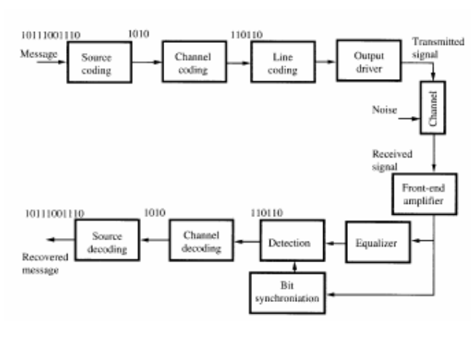
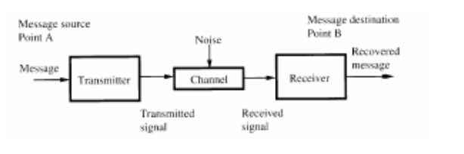
Building Blocks – Detailed Point-Pont Communication Link
Building Blocks of Elementary
Point-to-Point Link

Slide 13
Power budget in a fiber-optic link

Slide 14
Attenuation Limit

Slide 15
Dispersion-Limitations
Consider the pulse broadening Δt caused by the material-dispersion Dmat. In fibers there is an additional
dependence of the propagation vector β(ω) of the fiber mode on the fiber geometry leading to mode-dispersion Dmode . The total dispersion is approximated by the sum of the dispersions:

Slide 16
Receiver Sensitivity and Bit-Errors

Slide 17
LINK POWER BUDGET
The link power budget is an "accounting" procedure in which one calculates how much power can be lost between the transmitter and the receiver for a given receiver sensitivity (which depends on the bit rate) and transmitter power output. The resulting budget is allocated to connector losses, splice losses, fibre losses and a safety margin (system margin).
• dB and dBm units are used in the link power budget.

Slide 18
In practical applications, we often use components that have connectors attached. Fibre with one connector is known as a fibre pigtail. A length of fibre with connectors on both ends is called a patchcord.
In many link budgets, the splice loss is often combined together with the fibre loss.
We also include a safety factor known as the system margin (Ma) to account for component degradation. A typical value for Ma is 6 dB.

Slide 20
LINK RISE-TIME BUDGET
In the previous section, we saw how the maximum link distance is affected by the fibre attenuation and also the source power and the photoreceiver sensitivity for a given bit rate; this gave us the link power budget.
The total rise-time of the fibre-optic link is known as the system rise time tsys.
It depends on the rise-times of the individual systems components, and assuming these are independent of one another, they affect tsys as follows:
The usual requirement on tsys is tsys < 0.7 t, where t is pulse duration

Slide 21
Link Power Budget
Example:
Specifications: Data Rate 20 Mb/s, BER 10⁻⁹
Receiver: pin photodiode @ 850 nm → Required input signal = - 42 dBm
Optical source: GaAlAs LED with average optical power 50 µW = -13 dBm
Connector loss: 1 dB at both transmitter and receiver
System margin: 6 dB
Thus,
P_{T} = P_{S} – P_{R}
= 29 dB = 2(1 dB) + αL + 6 dB
αL = 21 dB
If α = 3.5 dB/km, then a 6-km transmission path is possible.

Slide 22
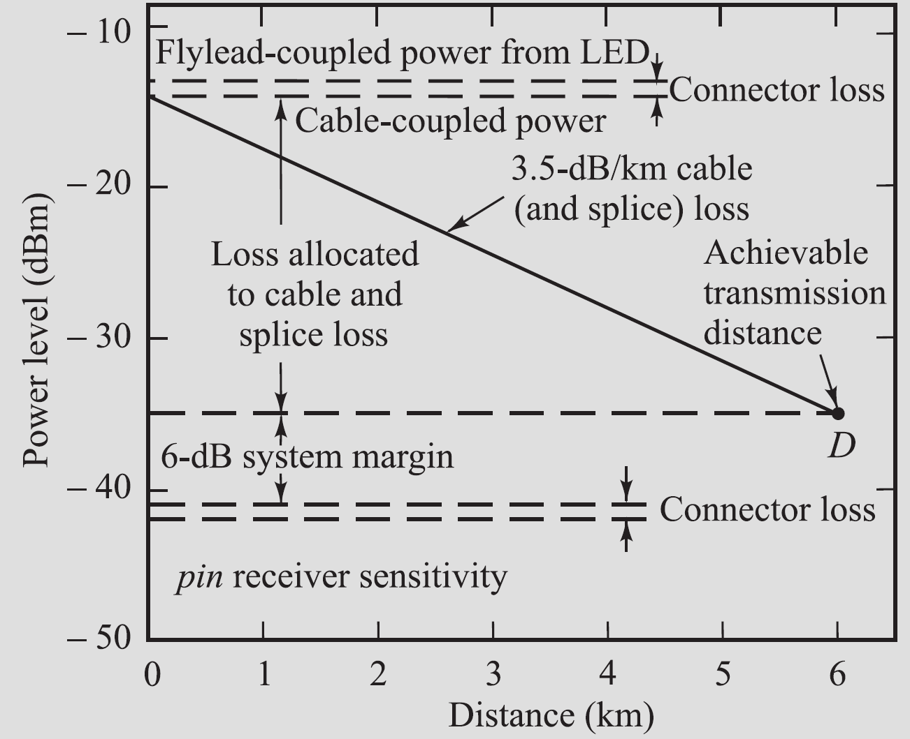
Link Power Budget
Graphical representation of a link loss budget for an 850-nm LED/pin system operating at 20 Mb/s.

Slide 23
Rise-time budget for a multimode link
Example:
Specifications: Data Rate 20 Mb/s, BER 10⁻⁹
LED : rise time 15 ns; spectral width 40 nm;
Fiber : material-dispersion related rise time 21 ns over 6 km link;
400 MHz·km bandwidth-distance product, q = 0.7 →t_{mod} =3.9 ns
Receiver : 25 MHz bandwidth → t_{rx} =14 ns
= 30 ns
For 20 Mb/s NRZ system, T_{b,NRZ} = 50 ns. Thus, t_{sys} < 0.7T_{b,NR}Z and the rise-time requirement is met.

Slide 25
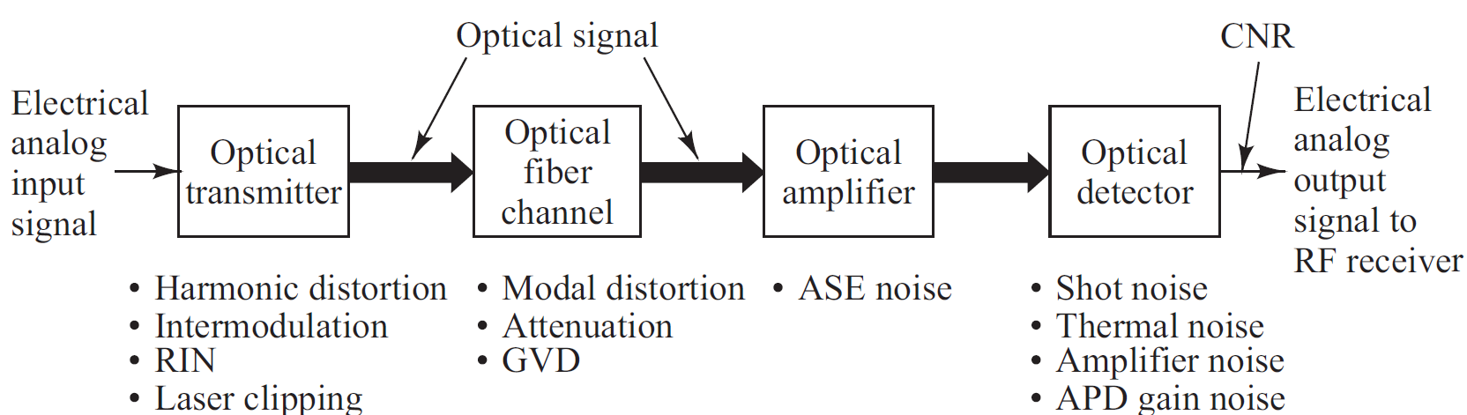
Analog Communication Links
Analog (RF) links are used where converting to digital signals is undesirable, including
• Analog TV and audio services
• Cable modem services
• Microwave-multiplexed signals (e.g., satellite base stations)
• Radar signal processing

Slide 26
Overview of Analog Links
A bias point on the source is set approximately at the midpoint of the linear output region. The analog signal can then be sent with direct intensity modulation technique.
Other modulation techniques include AM, FM and PM, which first convert baseband signal onto an electrical subcarrier prior to intensity modulation.
Signal impairments in optical source : harmonic distortions, inter-modulation (IM) products, RIN in the laser, and laser clipping.
The fiber should have a flat amplitude and group-delay response within the passband required to send the signal free of linear distortion.
Since modal-distortion-limited bandwidth is difficult to equalize, it is best to choose a single-mode fiber.

